Slide 1
For Live Session
Unit 10

Slide 2
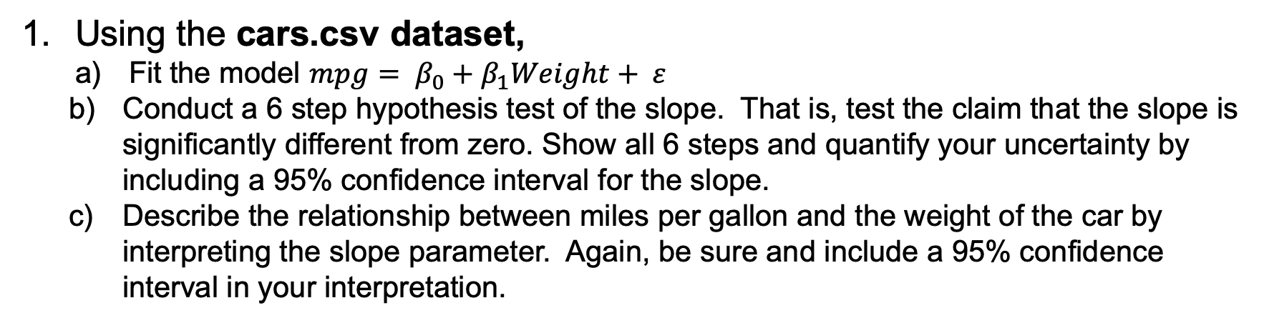
For Live Session: Question 1
Using the cars.csv dataset,
Fit the model $mpg= β_{0}+β_{1}Weight+ ε$
Conduct a 6 step hypothesis test of the slope. That is, test the claim that the slope is significantly different from zero. Show all 6 steps and quantify your uncertainty by including a 95% confidence interval for the slope.
Describe the relationship between miles per gallon and the weight of the car by interpreting the slope parameter. Again, be sure and include a 95% confidence interval in your interpretation.

Slide 3
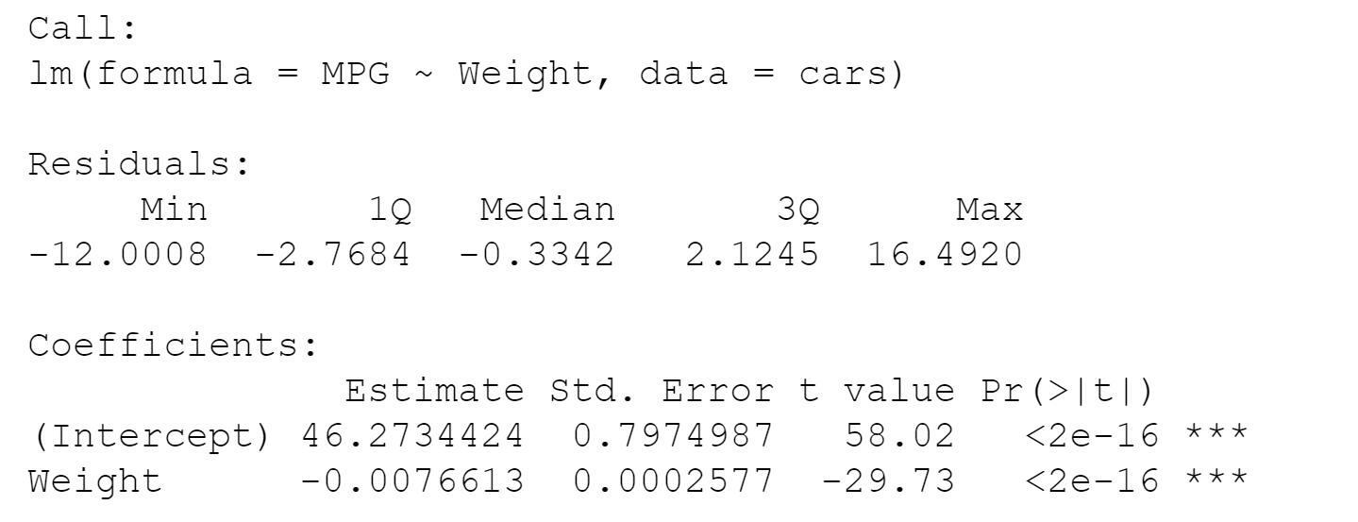
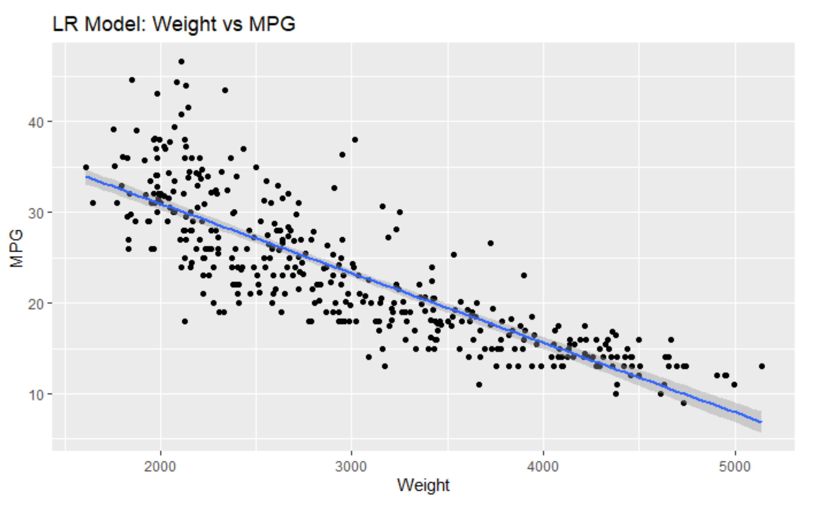

Slide 4
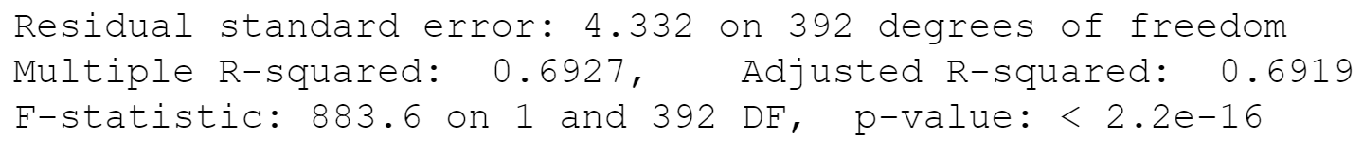

Slide 5
6 Step Hypothesis
H_{o}: Β₁ = 0
H_{a}: Β₁ ≠ 0
CI β₁= (3.23, 10.847)
β₁ p-value = 2.216e16
Do not Reject H_{o} for β₁
There is sufficient evidence at the alpha = .05 level of significance (p-value = 2.216e16) to suggest that the data are linearly correlated (or that the slope is nonzero). There is not sufficient evidence to suggest the intercept is not zero for the regression line. Consider collecting more data or eliminating outliers.

Slide 6
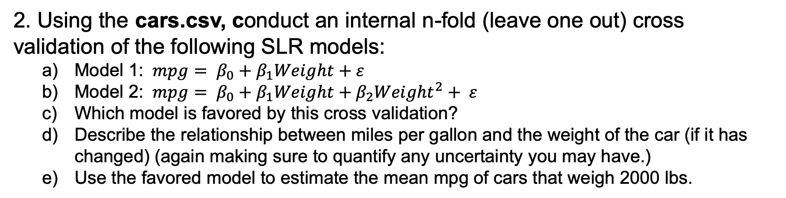
For Live Session: Question 2
2. Using the cars.csv, conduct an internal n-fold (leave one out) cross validation of the following SLR models:
Model 1: $mpg= β_{0}+β_{1}Weight+ε$
Model 2: $mpg= β_{0}+β_{1}Weight+β_{2}{Weight}^{2}+ ε$
Which model is favored by this cross validation?
Describe the relationship between miles per gallon and the weight of the car (if it has changed) (again making sure to quantify any uncertainty you may have.)
Use the favored model to estimate the mean mpg of cars that weigh 2000 lbs.

Slide 7
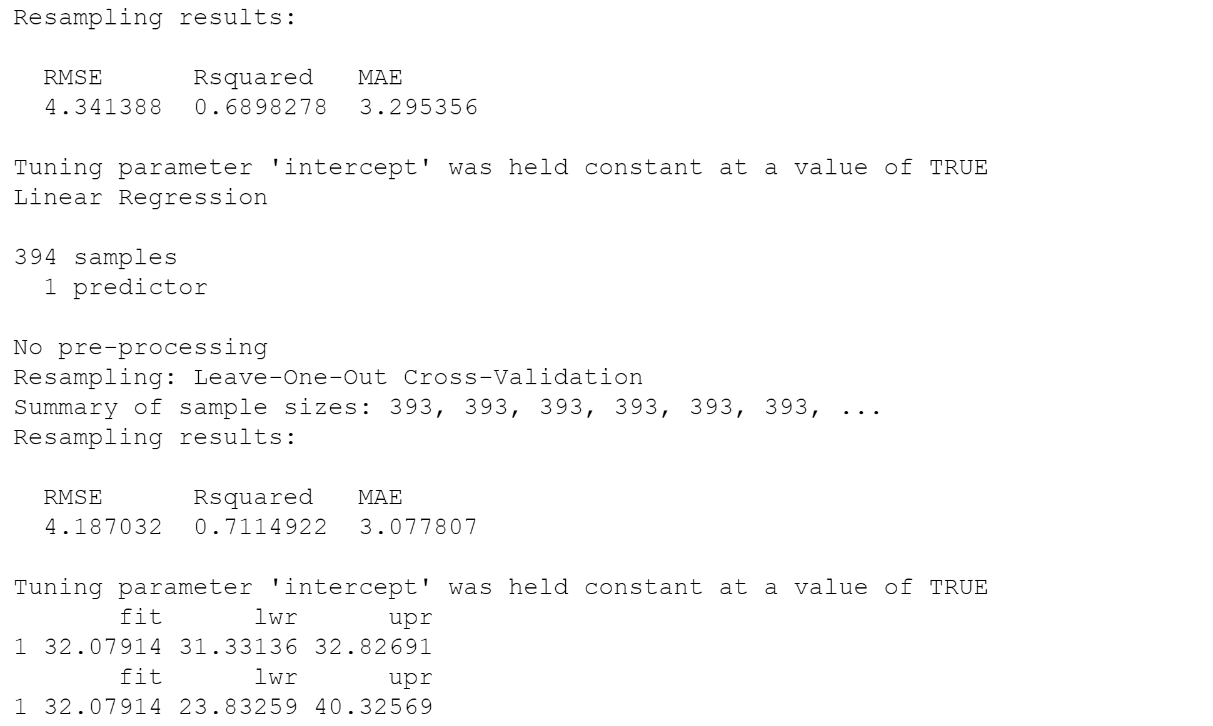
Model 1 & Model 2

Slide 8
For Live Session: Question 3
3. Using the cars.csv dataset, We would like to assess the relationship (interpret slope parameter) between mpg and horsepower. Notice that some of the horsepowers are missing.
Impute (predict and insert) the missing horsepowers by fitting a regression model.
You may use any of the variables as regressors EXCEPT for mps (since we will later be using horsepower to predict mpg.)
Assess the relationship between the mpg and the slope. Make sure and include estimates of your uncertainty (ie. Confidence intervals.)
Use your model and imputed data to estimate the mean mpg for a car with 250 horsepower.

Slide 9

